Slide 1
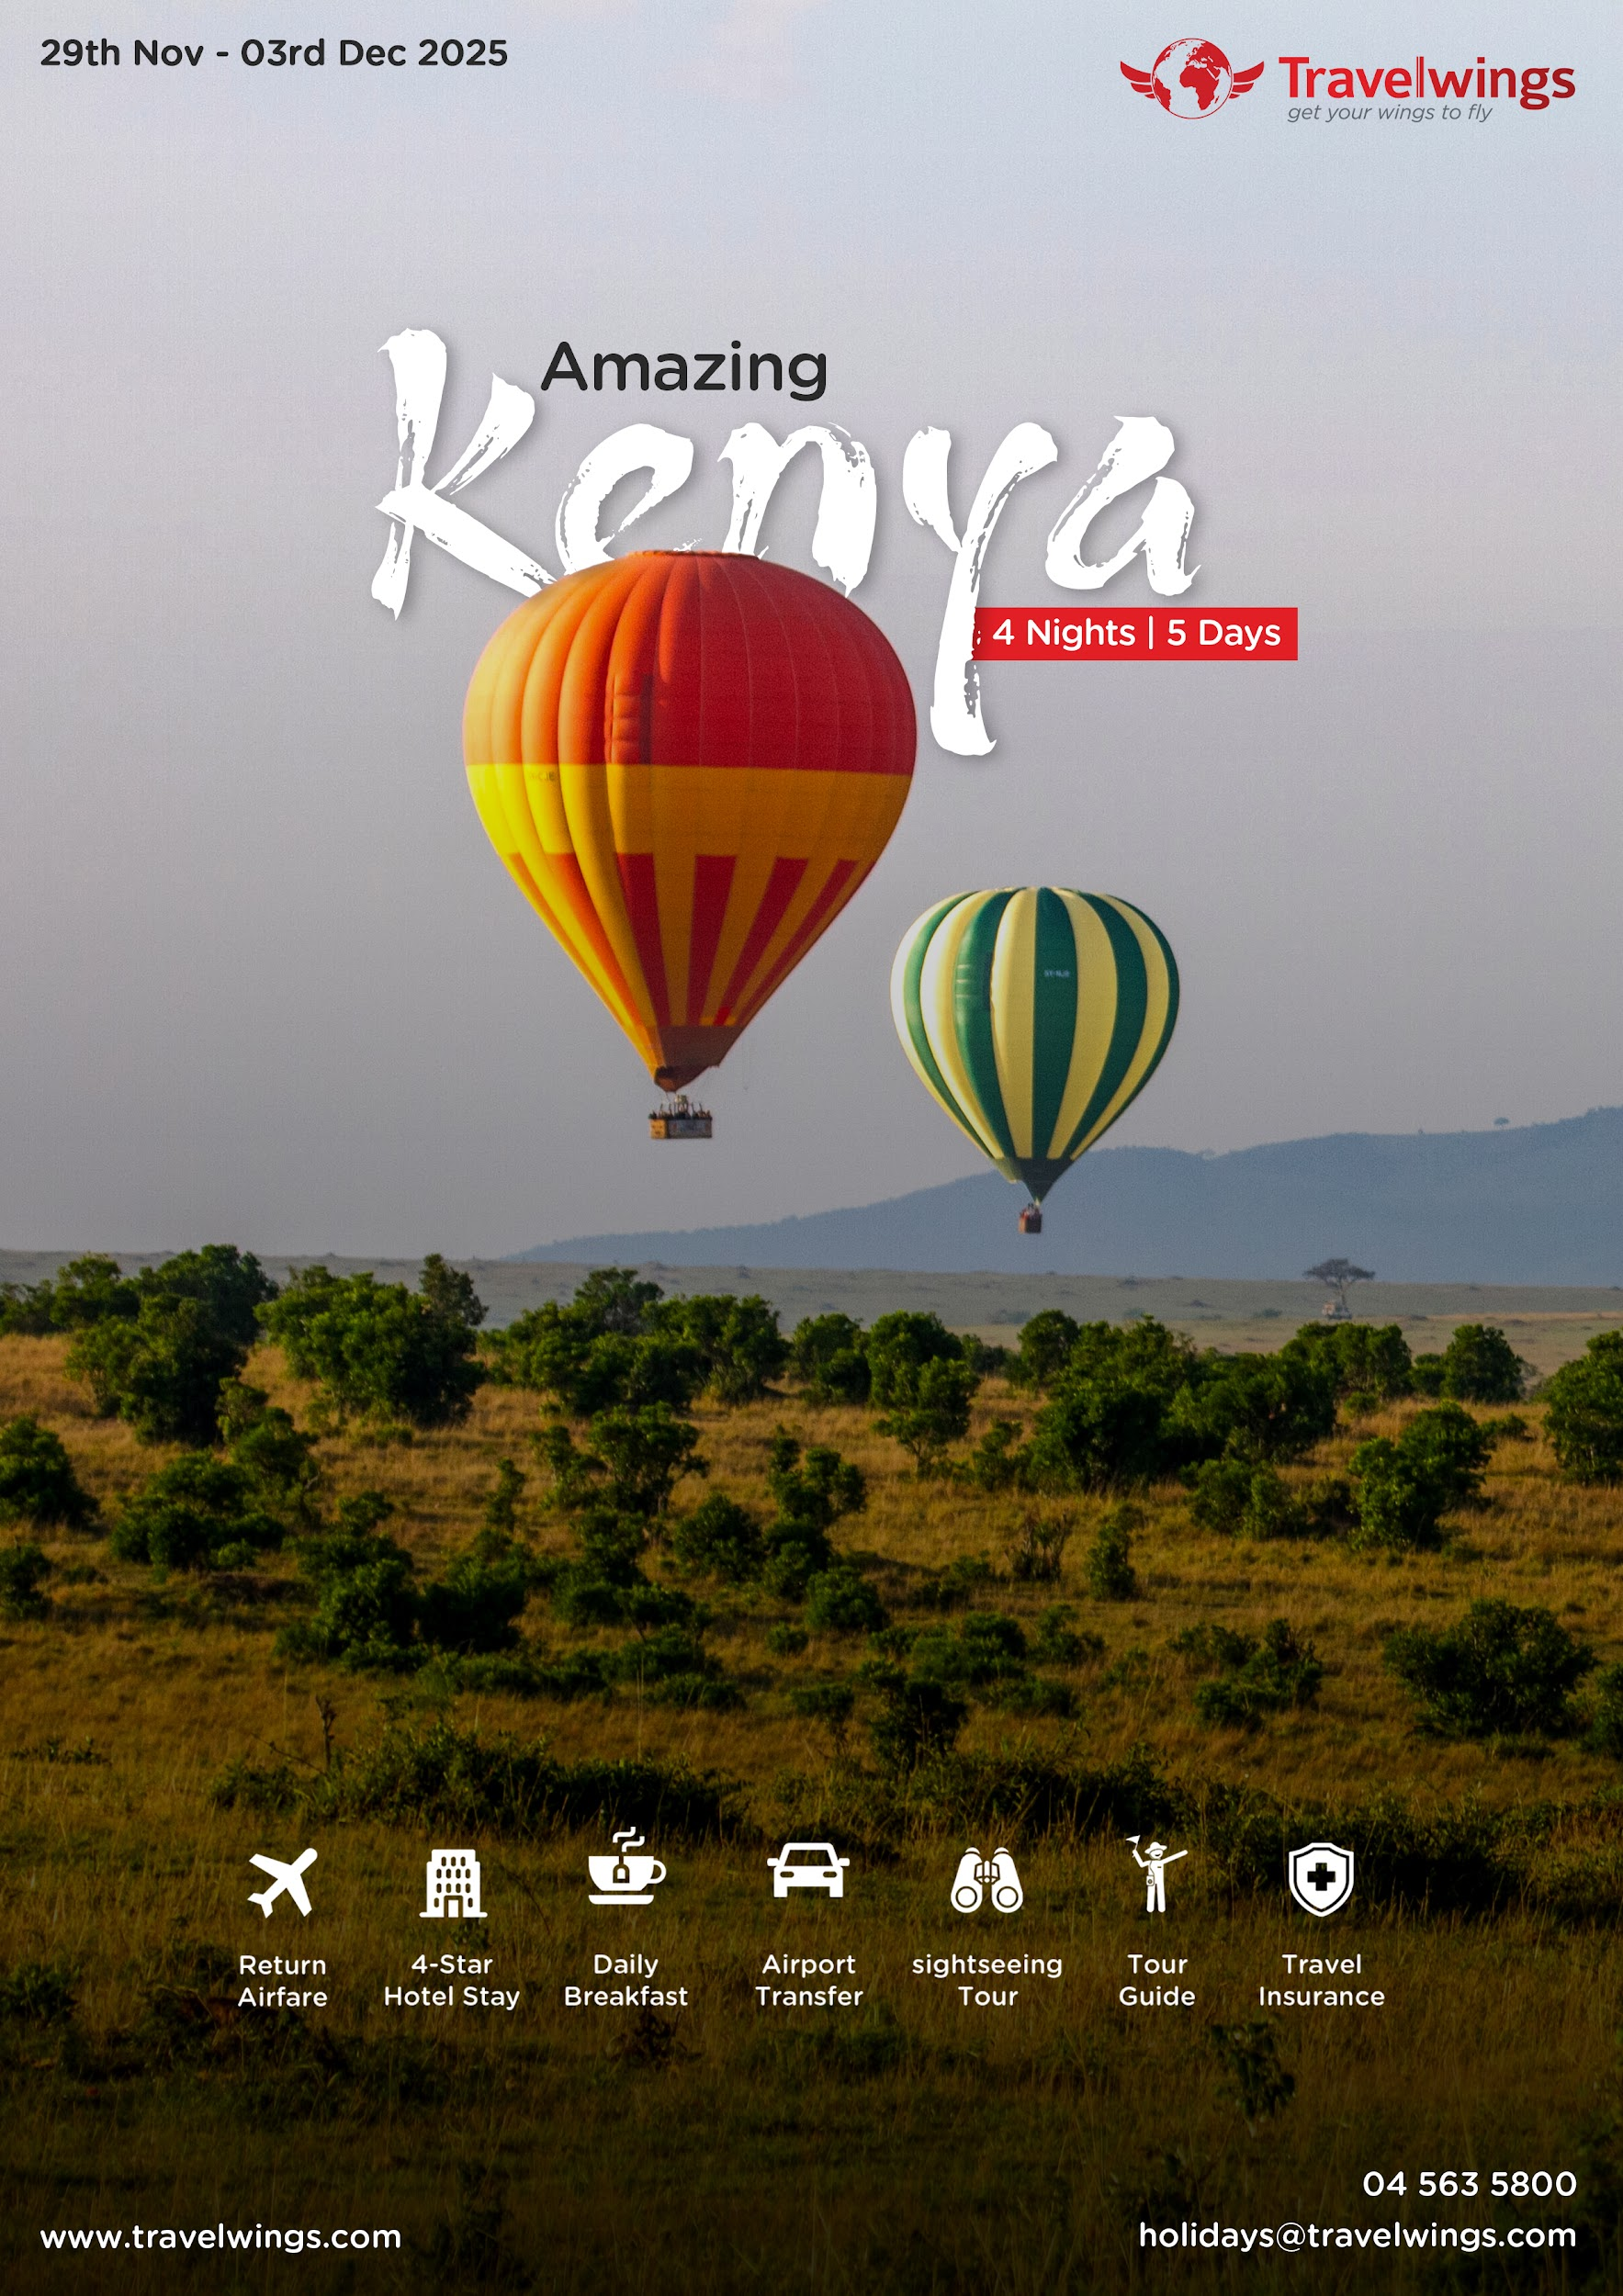

Slide 2





Arrival in
Nairobi
Giraffe Centre Visit & Transfer to Hotel
Upon your arrival at Jomo Kenyatta International Airport (JKIA), you will be warmly welcomed by your driver-guide and transferred to the Giraffe Centre, situated on the outskirts of Nairobi.
This sanctuary is devoted to the preservation of the endangered Rothschild giraffe.
You'll have the chance to feed and interact with these gentle creatures while learning about ongoing conservation efforts.
Following your visit, a snack box will be provided before proceeding to your hotel in Nairobi for check-in.
The remainder of the day is free for you to relax and recover from your journey.
Overnight stay in hotel at Nairobi.
Meal : Snack Box
www.travelwings.com 02

Slide 3





Nairobi to
Maasai Mara
Afternoon Game Drive
After breakfast, you will depart for the world-renowned Maasai Mara National Reserve, one of Kenya’s premier wildlife havens.
Your journey will take you through the picturesque Great Rift Valley, offering stunning vistas of expansive plains and rolling hills.
Upon arrival in the Maasai Mara, you’ll check in at your lodge and enjoy a freshly prepared hot lunch.
Later in the afternoon, set out on your first thrilling game drive through the reserve. The Maasai Mara is celebrated for its rich wildlife, including lions, elephants, giraffes, cheetahs, and more.
The Mara is also the stage for the famous Great Migration of wildebeest and zebras (season permitting).
Dinner and overnight stay in the Maasai Mara.
Meal Plan: Breakfast, Lunch & Dinner
www.travelwings.com 04

Slide 4

Full-Day Game Drive in
Maasai Mara
After a hearty breakfast, prepare for a full-day adventure in the Maasai Mara with an extended game drive across the reserve.
A packed lunch will be provided, which you’ll enjoy at a picturesque picnic spot within the park.
The Maasai Mara offers some of the best wildlife viewing in Africa, giving you the chance to spot the iconic “Big Five” — lion, leopard, elephant, buffalo, and rhino — along with an incredible variety of birdlife.
Return to the lodge in the evening for a delicious dinner and overnight
Optional Tour Add Massai Village Tour at extra cost USD 25
Meal Plan: Breakfast, Lunch & Dinner
www.travelwings.com 07

Slide 5

Maasai Mara to Naivasha
Boat Ride
on Lake Naivasha – Nyahururu
After breakfast, you will head toward Naivasha, nestled at the floor of the Great Rift Valley.
Upon arrival, enjoy a delicious hot lunch at your lodge before setting out on a picturesque boat ride across Lake Naivasha, one of Kenya’s most tranquil and scenic lakes.
The lake is a haven for birdlife, including pelicans, and you may also spot hippos along the shoreline.
After your boat excursion, you’ll continue your journey to Nyahururu, where you will check in at your hotel for the night.
Dinner and overnight stay in Nyahururu.
Meal Plan: Breakfast, Lunch & Dinner
www.travelwings.com 08

Slide 6

Visit to the
Equator & Thompson Falls
Transfer to Nairobi for Departure
After breakfast, begin your day with a visit to the Equator for a memorable photo opportunity at this iconic geographic landmark, where you can witness the fascinating Coriolis effect in action.
Next, head to the breathtaking Thompson Falls, a 74-meter-high waterfall near Nyahururu, offering scenic views and excellent photo moments.
Following your visit, you will drive back to Nairobi for a drop-off at Jomo Kenyatta International Airport (JKIA) in time for your return flight.
Meal Plan: Breakfast
www.travelwings.com 10

Slide 7






Inclusions
Round Trip Economy Class Airfare via Kenya Airways
20 kg baggage allowance and 7 kg hand luggage allowance
Transport on Day 1 in AC Coach to giraffe center
01 Nights stay in Nairobi at Sarova Panafric or similar.
02 Night stay in Masai Mara at Drunken Elephant Mara or similar.
01Night stay in Nyahururu at Panari Nyahururu or similar.
Standard Room with Daily Buffet Breakfast (Except on Day 1)
03 Lunches & 03 Dinners
Snack Box on Day 1
Games Drives in Safari Land Cruiser as per the itinerary
Giraffe Center in Nairobi
Boat ride on Lake Naivasha
Visit to Thompson falls & Equator
1 Bottled of 500 ml drinking water during the tour
Premium Travel Insurance
Transport and transfers in a safari 4x4 land cruiser with a pop-up game-viewing roof hatch (Non A/C).
Note: If the traveller is aged 60 years or above, a supplementary insurance charge will be applicable
Hotel Details
City
Hotel Name
Category
Google
Nairobi
Sarova Panafric
4 Star
Masai Mara
Drunken Elephant Mara
4 Star
Nyahururu
Panari Nyahururu
4 Star
Flight Details
Airlines
Date
From
To
Flight
Dept.(Hrs)
Arr.(Hrs)
Kenya Airways
29 Nov 2025
Dubai
Nairobi
KQ305
06:55
11:10
Kenya Airways
03 Dec 2025
Nairobi
Dubai
KQ310
18:15
00:30
Food & Seat Selection: If the airline permits pre-booking, we can arrange it for an additional fee. Alternatively, these can be handled directly by the guest at the time of boarding, subject to availability during booking.
Package Cost
Cost per person on a twin / Double / Triple sharing basis
6,849
Cost per person on a single occupancy basis
7,549
Cost per child with bed (6 years of age to 11 years of age)
3,599
Cost per child without bed (2 years of age to 5 years of age)
3,499
Cost per infant (0 years of age to 1.99 years of age)
999
www.travelwings.com 12

Slide 8



Exclusions
Visa Fees & Assistance
Flight seat allocation
Any meals in the aircraft
Lunch & Dinner (wherever not included)
Early check-in or late check-out charges
Tips for the local guide and driver
Optional tours or Additional sightseeing, activities, & experiences outside of the itinerary
Drinks including water in the lodges even at meal times
Visa Information
ETA costs approximately USD 55 per person . Visit the link Click Here. (varies as per the nationality)
Processing visa time is 3 to 4 working days
Payment & Cancellation Policy
45 days or more from the departure date - 25% of the package cost to be paid (non-refundable).
Between 30 to 45 days from the departure date - 50 % of the package cost is to be paid (non-refundable).
Less than 30 days from the departure date - 100% of the package cost (non-refundable).
Full refund is only applicable in the case of flight cancellation due to COVID restrictions and lockdown measures in the respective destinations as per the Ministry of Foreign Affairs of the country .
In Case of Visa rejections /cases where the customers are offloaded at the airport or by immigration, the penalty will be applicable as per the Cancellation policy
www.travelwings.com 11

Slide 9
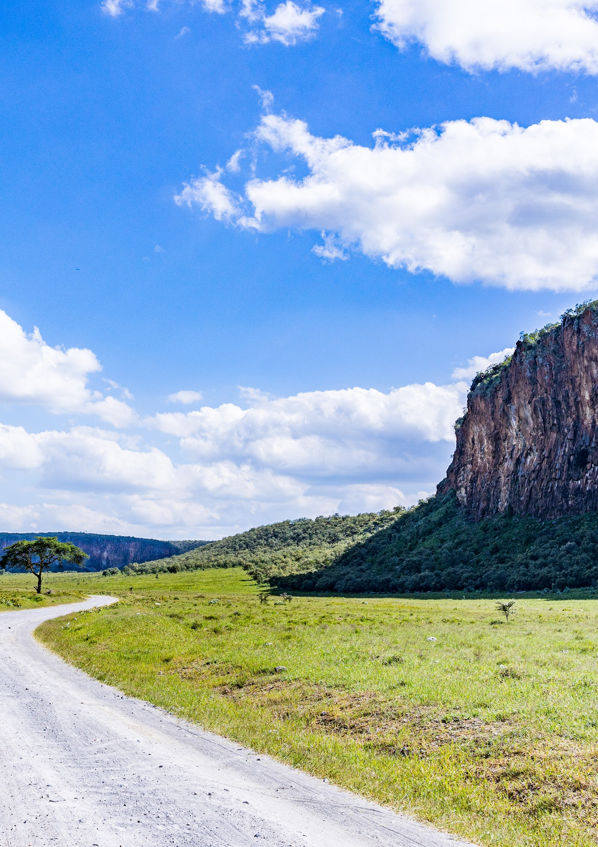
Term & Conditions
The validity of the package is from 29th Nov - 03 Dec 2025.
The package offered is operated in a Group exclusively for Travelwings
The prices offered are as per the current promotions and respective offers would be valid at the time of confirmation.
Bookings will be confirmed as per the payment policy.
Prices are dynamic and based on offers running at the time of booking. We reserve the right to change prices at any time.
If the visa is not specified in the package, it is not included. Please note that the final decision regarding visa applications rests solely with the respective Embassy/Consulate.
Travelwings have nothing to do with any last-minute changes in Visa requirements and regulations of the country.
The passport must be valid for at least 6 months from the return date of departure. Client’s responsibility to obtain correct, current, and valid passports and re-entry permits where required. Please reach out to our team if you need any help with this.
Any changes or delays in flight schedules are at the sole discretion of the airline. We recommend checking your flight status 24 hours prior to departure, as schedules may change without notice.
Food and seat selection vary by flight. If not included, they are chargeable and subject to availability according to the airline's policy.
For group departures, if the airline allows us to pre-book food and seat selection for an additional charge, we will do so for the guest. In cases where the airline doesn't allow pre-booking, the guest may book food and seats at the counter or directly with the airline during boarding, subject to availability.
The food menu (Veg/Non-Veg) is determined by the airline and hotel policies, and we have no control over it.
We retain the authority to alter the itinerary under various circumstances,including but not limited to force majeure events, strikes, fairs, festivals, weather conditions, traffic issues, overbooking of hotels/flights, flight cancellations or re-routing, closure of a place of visit, entry restrictions, and other unforeseen situations. While we strive to arrange suitable alternatives, we cannot be held responsible for any refunds or compensation claims arising from such changes.
If a flight is cancelled, we are not obligated to offer alternative flights at the same cost. Any additional costs incurred for securing an alternate flight will be the responsibility of the traveller.
For the extra tour/ optional tour, English Speaking Driver cum guide will be provided if it's less than 3 pax
In case the selected hotel is unavailable due to an unexpected situation, an alternate arrangement will be offered to the customer in a hotel of a similar category.
The availability of adjoining rooms/ interconnecting rooms/non-smoking rooms/rooms on the same floor etc. cannot be guaranteed.
Room type (double or twin) is subject to availability and is at the sole discretion of the hotel.
Standard hotel check-in time is 1400 Hours and check-out time is 1100 Hours local time. It may vary based on destinations and availability.
At the time of check-in to your hotel, the hotel may ask you to make an advance/security deposit (the amount depends upon the hotel policy). This amount is refunded at the time of check-out, minus the cost of any items taken from the mini-bar or other charges (like late check-out or any damages done to the room).
All tours and transfers by sharing coach on the group, the client should follow the timing on the ground. If any transfer is missed, Travelwings will not be responsible, and the client will bear the extra cost
Any ticket to attractions, museums, trains, cable cars, ferries, rides, safari, etc. is not included unless explicitly mentioned as an inclusion.
The activity/sightseeing changes are subject to availability and operational days, the itinerary might change due to the same on ground.
If any service or tour is canceled on-site due to unforeseen circumstances, we will provide an alternative sightseeing option or issue a refund for the specific service or tour affected.
If any service or tour is missed by the guest, the package price will remain unchanged, and no refund will be provided for the unused service.
If you face any issues during the tour, inform the Travelwings representative immediately for prompt resolution, as we cannot address them after the tour is completed.
Customers are fully responsible to carry proper travel documentation (make sure that all travel documents are valid and complete and check the entry requirements for your upcoming trip before you travel).
No refund can be given for air tickets and partially used services.
We do not accept any responsibility if the passenger cannot travel because of any passport or visa issue.
The above mention cancellation policy will apply from the day of the initial booking date.
www.travelwings.com 13

Slide 10

www.travelwings.com 14

